Slide 1
Exploring Preterm Births with K-Means and Other ML Techniques
AI in Healthcare
Self Learning Tutorial
10/2026
https://github.com/AIHfall2026/Self_Learning_Tutorial_Fall_2026/
Notes:
In this tutorial, we look at the CDC’s 2023 linked birth/death infant data so that we can attempt to perform cluster analysis on preterm/premature births using a combination of different ML methods, e.g., K-Means, Gaussian Mixture Models. We also do survival analysis to see how the different groups of preterm babies survive over the course of their first year.

Slide 2
Motivation
A preterm or premature birth is defined as a birth of a baby before 37 weeks
In the US, approximately 10% - 11% of births are preterm
Premature birth can have a wide range of outcomes and impacts on those children and their families
CDC’s linked infant birth/death records has data on preterm births.
Goal: can we look at the data to group different types of preterm births and measure what, if any, different outcomes they face.
Use ML methods in this case
Notes:
It’s worth mentioning that although any birth before 37 weeks counts as preterm, how early the baby is born is extremely important to know, both to understand the potential causes and to predict future outcomes. A baby born at 36 weeks will be assessed very differently vs one born at say 20-25 weeks. Indeed, a baby born at < 22 weeks is likely not to survive. On the next slide we will see how common preterm births are.
Since we want to find out what clusters there are in the data for preterm births and look at how the babies fare in their first year, we can use methods like K-means clustering to find structures in the data that we then investigate.

Slide 3
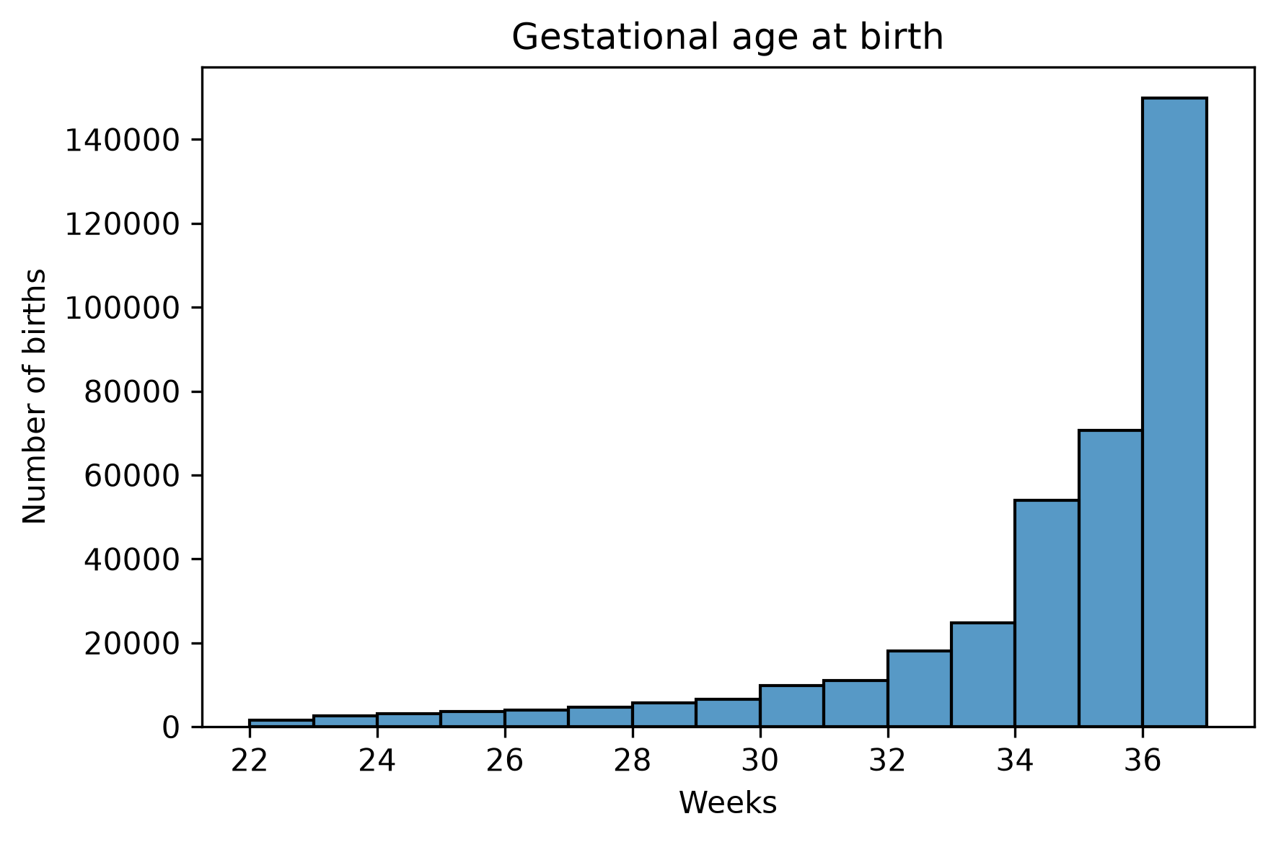
Notes:
Most preterm births happen >34 weeks, but a sizable amount happen before that (on an absolute basis for sure). On the next slide we look at the distribution of birth weights.

Slide 4
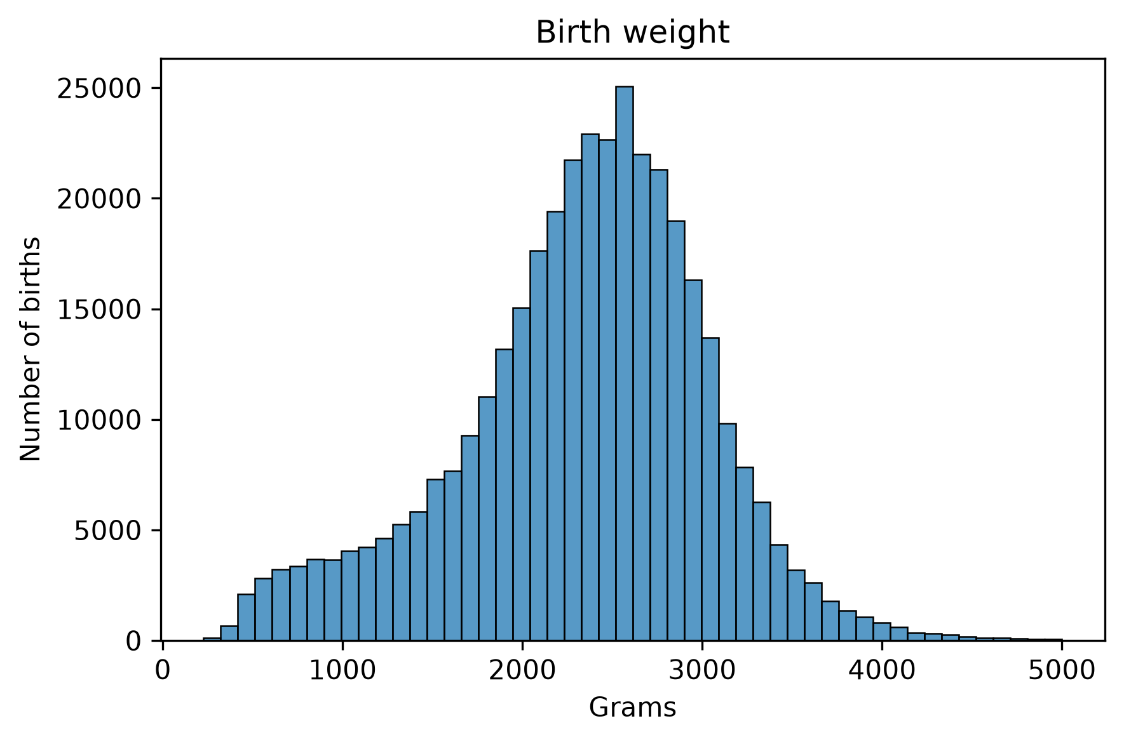
Notes:
This chart shows the distribution of birth weights. Babies > 5000 grams were excluded (and extremely rare in the data in any event). But we can see that the taper for larger babies is more pronounced vs the taper for smaller babies on the left. Premature births contribute to the skew that we are seeing in the measurements.

Slide 5
CDC Linked Infant Birth and Death Records
Our basis for analysis is the CDC 2023 cohort of infant birth and death records (CDC tracks all deaths of infant before the age of 1).
The data can be found from the US CDC National Center for Health Statistics: https://ftp.cdc.gov/pub/Health_Statistics/NCHS/Datasets/DVS/period-cohort-linked/2024PE2023CO.zip
For US residents, we saw that there were > 373K preterm births in 2023 (out of > 3.6M births total), and we ultimately looked at > 367K of those records
Roughly 9.5K of those records that we looked at ended in a death before the age of 1
Notes:
In the CDC data, one birth corresponds to one row in the data (births with multiple babies present would be spread out over that many rows). For any baby that died before the age of 1, that row is linked to the death records, which we use in our analysis to study survival curves.
Note that we filtered out some rows in the data e.g., in particular we only used US residents as this is a standard practice for this kind of analysis.
The code is available in the GitHub repository, but given upload limitation for GitHub (both in the web GUI and through terminal commands), users of this repo will have to also separately download the ZIP files from the above source and put them in the directory. The downloaded ZIP file 2024PE2023CO.zip must be unzipped in the same directory as SLT_Project.ipynb notebook and the resulting folder file name (2024PE2023CO) should be left as is.

Slide 6
Reading in the Data
Each row in the data represents one birth, but contains no commas or column headers
Instead the field values live in fixed positions in the rows
We use the CDC user guide for this dataset to develop this schema and store it in a dictionary called FIELDS.
User guide: https://ftp.cdc.gov/pub/Health_Statistics/NCHS/Dataset_Documentation/DVS/period-cohort-linked/24PE23CO_linkedUG.pdf
Notes:
We used the user guide to set up the FIELDS dictionary, which contain the different features to consider for cluster analysis, e.g., diabetes, history of preterm births, certain infections. Later on we will filter some of these out further. But each item in the FIELDS dictionary contains a feature, and a range containing which spots in the row contain the value for that feature. The dictionary highlights what those features mean. We read in chunks of the data 500K lines at a time for machines with less powerful hardware/RAM capacity.

Slide 7


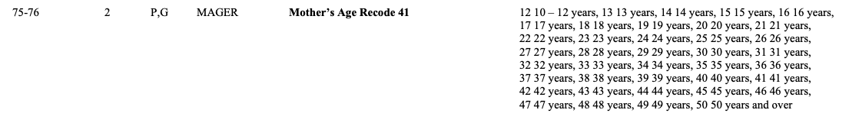
Notes:
Snippets of FIELDS dictionary. Note that we exclude rows where “restatus” == 4.
The bottom two lines of code show how we ingest the data as text first using Pandas read_fwf 500K rows at a time. Note that the guide starts indexing from 1 while python indexes starting from 0, so a minus 1 offset is required.
The final image is that of the field codes and values as listed in the user guide PDF

Slide 8
Data Cleansing
Once we load the data we make some changes, e.g., convert numbers stored as text into numerical objects. Unknown values are given special values in the user guide and we apply those values to filter out rows where necessary.
Example: Yes and No fields are assigned to 1 and 0, and unknown values are assigned NaN.
Infant deaths are tagged as 1 if the birth record can be linked to a death record. Otherwise it is tagged as 0.
All records where the birth weight was guessed are dropped
Notes:
In the user guide, there are different conventions for missing or unknown data. So in Birth Weight feature, a value of “9999” means unknown. After we map the “9999” to a numerical value, we tag the cell as a NaN. This is for the continuous case, if it is a Y/N field with an unknown value U, we map that to NaN in the row. For the features that we care about for clustering, features with NaN values leads to the rows getting filtered out.

Slide 9
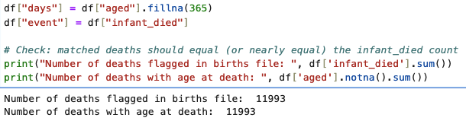
Linking Birth and Death Records
For a baby born in 2023, its death can occur in 2023 or 2024, so we need the two death certificate files in 2024PE2023CO
Death records share two values with birth records, a sequence number and year of death. We use both of these to identify a link since sequence numbers are reset each year (and thus do not link a birth to a death on their own)
We merge the data with the age at death and cause of death whenever applicable to the corresponding birth
Notes:
You can see that we successfully extracted all the almost 12K deaths data from the certificates with the birth data in the dataframe (even though not all of these rows were used in our analysis). The survival analysis will rely on this and two additional data points for each baby: the number of days that the baby was followed for and if the baby died.

Slide 10
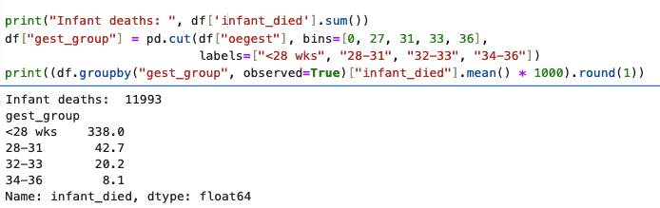
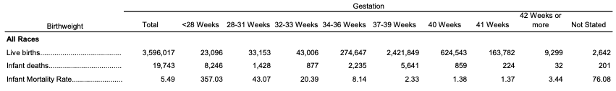
Data Validation
Notes:
As an internal check, we make sure that our death rates per 1000 babies matches closely what the data says (since some records were dropped by design some deviation is expected). We see some patterns already which should be obvious, e.g., an earlier birth leads to more deaths in the first year, especially for children born < 28 weeks.

Slide 11
Filtering the Data
In our analysis we started with > 3.6M births.
Our focus on preterm births to US residents resulted in us keeping only 373902 rows in the data that correspond to this filter.
From there, we remove preterm births before 22 weeks and remove births where the birthweight was > ~11 lbs, which left 370003 rows in the data. This also removed >2500 deaths associated with preterm babies <22 weeks old.
Finally, we removed rows that have missing feature data. All in we looked at 367081 birth cases.
Notes:
The exact data confirms that roughly 10% - 11% of births are preterm. We removed the rows that are < 22 weeks old as these are very likely to have resulted in death but not be associated with any of the features in our data, so we don’t include them. The 11 lb threshold is because we want to exclude datapoints that are generally not observed in these populations. Combined these rules removed < 2700 datapoints, most of which were associated with the <22 week gestational periods for the preterm births that we wanted to exclude.

Slide 12
Choice of Cluster Features
Rules for cluster choices:
  Features must have been known at or before birth
  Feature had to be a known risk factor for a preterm birth
These features chosen were as follows: gestational age, birth weight, whether delivery was for more than one child, e.g., twins, pre-pregnancy hypertension, gestational hypertension, eclampsia, pre-pregnancy diabetes, gestational diabetes, infection (Chorioamnionitis), previous preterm birth, fertility treatments, maternal age, and smoking
Notes:
It’s worth noting that for infections, there were more than one type, but they were not numerous and likely would have resulted in point clusters in our analysis. There’s an argument to be made for grouping all the infections together but that is too broad a group. Chorioamnionitis was recognized as an infection that was a specific risk factor so it gets its own count.
For K-Means, which measures distance, we take a standard approach and standardize the features so that they are mean 0 and variance 1, as leaving them as is would leave Y/N, e.g, 0 or 1 features highly sensitive to features like birth weight which are much larger in magnitude (since they are measured in grams), e.g., birth weights would dominate the Y/N features.

Slide 13
Choice of K
For practical purposes we look at values of K = 2, 3, …, 8 and then make a decision on a “good” value for K.
After we test run K-Means clustering for those different values for K, we look at two measures of quality: Inertia and Silhouette scores.
Notes:
Recall that for K-Means the number of clusters has to be known a priori for the algorithm to run. As a practical matter we could use a higher number of clusters at the price of additional computational power. One choice of K need not be correct over the other if you have a view on what the number of clusters should be.
Inertia measures sum of the total squared distance from each birth to its putative cluster center. Adding clusters lowers this value, but we look for the point of diminishing return, e.g., the inflection in the elbow curve that this method often produces.
The Silhouette score tracks how well clusters are separated. It’s not practical to run it on all ~367K records, so we try it on five random samples of 10K births. We are to choose the highest Silhouette score that we see

Slide 14
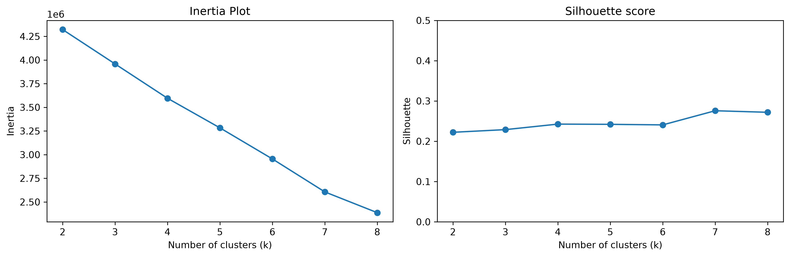
Choose K = 7
Notes:
K = 7 doesn’t present as an obviously strong elbow shape, but we see that going from K = 7 to K = 8 yields a less steep decline than going from K = 6 to K = 7. K = 7 is the closest we have to the elbow inflection that we are looking for.
Likewise, the Silhouette score for K = 7 is highest with a value of 0.276. It’s worth noting that this score is fairly low and yields clusters that overlap, but this phenomenon is not uncommon in clinical data. Since they agree we choose K = 7.
For future analyses we could attempt to group with a higher number of clusters.

Slide 15
7 Chosen Clusters
Very preterm, unexplained
Infection associated
Pre-existing diabetes
Fertility treatment
Eclampsia
Recurrent preterm delivery
Late preterm, unexplained.
Notes:
We chose the number of clusters K, and upon analysis K-Means chose the groups (listed above). Rare conditions often end up in their own clusters, but those that show up in many clusters (e.g., gestational hypertension) can overlap across clusters.

Slide 16
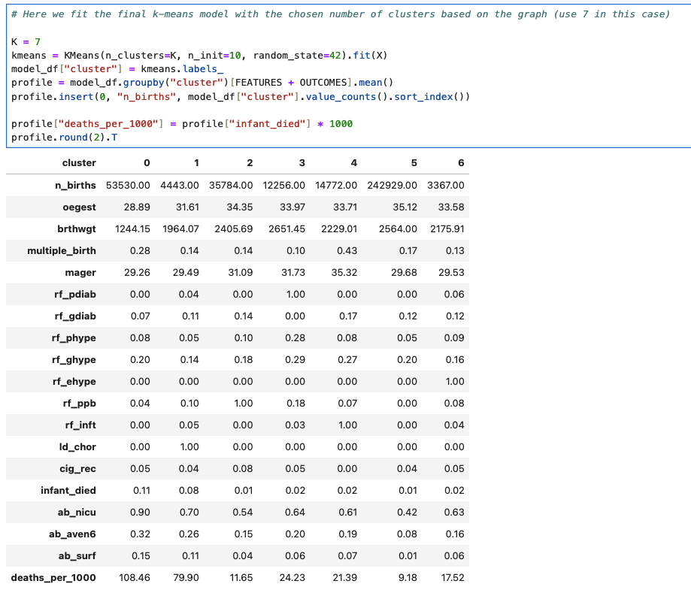
Notes:
The chosen clusters are a function of the features chosen, the data, the value of K and how K-Means is measuring distance. Five clusters line up with the recognized risk factors of preterm births. The others are very early or very late preterm births.

Slide 17
Use PCA to Visualize Clusters
Principal component analysis (PCA) allows us to linearly project onto lower dimensional space to see the directions along which the data varies the most.
In our analysis, along the first axis variation stems from when the baby arrived (early/late preterm) together with its birth weight
Along the second axis, the biggest drivers are maternal age and the mother’s health, e.g., infertility treatment, pre-pregnancy hypertension, etc.
Some features like Eclampsia or gestational hypertension don’t register in the PCA chart
Notes:
Overall PCA can be helpful but doesn’t necessarily capture the whole picture of what is going on in the data as certain features and their clusters can get lost in the projection

Slide 18
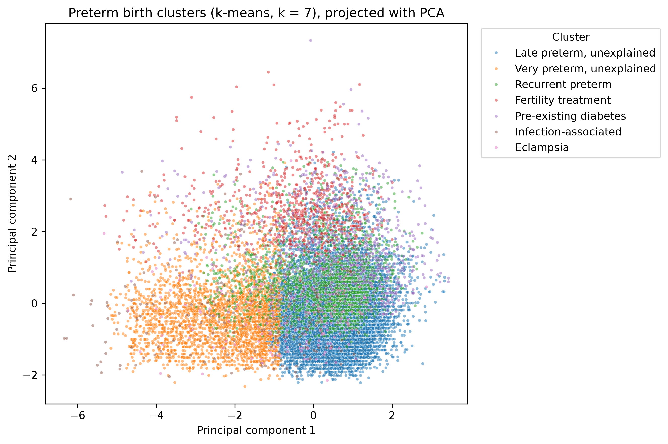
Notes:
We see the strong grouping associated with whether a baby arrives late preterm or very preterm. Other categories don’t register variation as much

Slide 19
Gaussian Mixture Model
K-Means will give us the clusters we ask for (as long as we have at least K datapoints).
How do we know if we captured the right clusters?
We test the same data using a Gaussian Mixture Model to give us 7 clusters.
GMM models each group as a normal distribution and gives a confidence level for each assignment
Compare the results using an Adjusted Rand Index
Notes:
The ARI tracks how well our methods (K-Means and GMM in this case) group births into the same bucket.

Slide 20
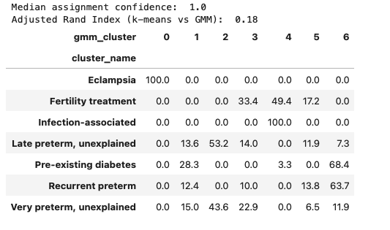
GMM Results + ARI
Notes:
There was strong agreement in the Eclampsia and infection-associated column, but the 0.18 score suggests that the two methods largely disagree in their results. For these two categories we have some more confidence that we should use them. We also looked at focusing on features that could be modeled continuously and where the ARI would potentially show more agreement with K-Means.
Note that the median assignment confidence of 1.0 (100%) is not a realistic value since it carries way too much certainty.

Slide 21
Survivability Analysis of the K-Means Cohorts
Since we could not generate wider agreement between our K-Means and GMM models, we stick with the K-Means clusters.
Then we want to understand how babies in each cluster survive during the first year
We use Kaplan-Meier curves to show this
Notes:
In this setting Kaplan-Meier curves try to estimate the share of babies still alive at a given point during the first year (the data only tracks for the first year, and if there is no death certificate in the linked data then the baby survived).

Slide 22
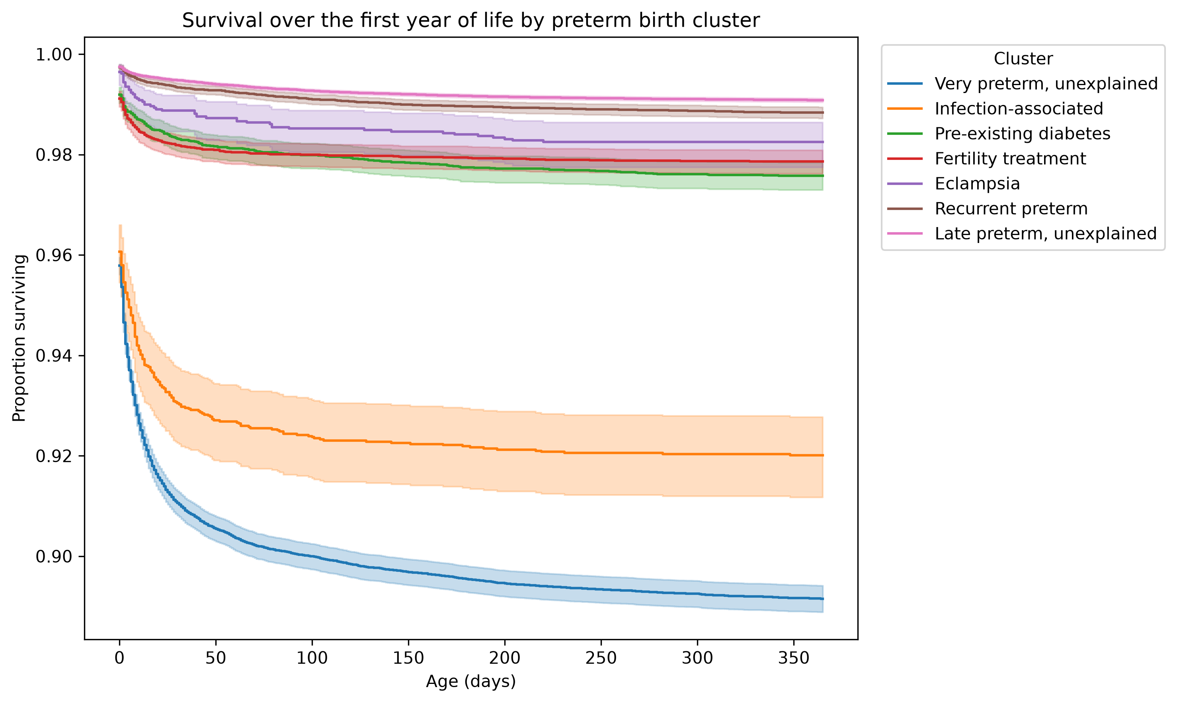
Notes:
The babies with the highest risk of death are the very preterm babies and those that are infection associated. Still, even the very preterm babies are estimated to survive 89% of the time to one year. The shaded bands around the curves represent 95% confidence intervals. Typically larger clusters have more narrow bands and smaller clusters have larger bands. This is because the less data we have the more of a spread that is required to be confident in the estimate.

Slide 23
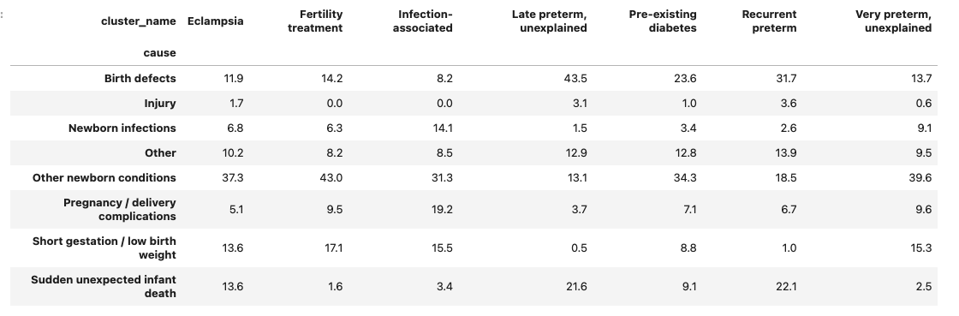
Causes of Death in the Cluster
Notes:
To see what precisely caused premature death in the babies, first target a cluster (column header) and then look at the rows. We see that in the fertility treatment cluster, the largest share of deaths was caused by other newborn conditions (43%). For late preterm baby deaths, the main cause was birth defects. All of the columns add up to 100% to account for each groups causes of death.

Slide 24
Design Limitations
We made several assumptions about the data, e.g., ignoring preterm babies < 22 weeks old and babies > 11lbs at birth, which removed > 2500 death links
Clinical data often overlaps but this often leads to lower Silhouette scores, which we saw when we did the K-Means cluster analysis
We could have also chosen different top values for K, e.g., > 8.
The nature of our feature sets (many Y/N, e.g., 0 or 1 features) tended to form their own clusters, which made the GMM less robust as a method.

Slide 25
Future Work
Work with MIMIC-III data, which also has information on preterm births
Use other clustering algorithms
Use social factors in our analysis, e.g., education, race, insurance type, etc., which can have an impact on preterm births

Slide 26
Conclusions
Can use unsupervised ML methods to cluster the data
Clusters are highly sensitive to the methods used, features, and choices/assumptions made by us (the practitioners)
Overall, gestational age, e.g., how early or late the baby was born, was the most strongly associated with survivability.

Slide 27
Bibliography & Hardware/Software Versions
National Center for Health Statistics. (2026). Linked birth/infant death public use file: 2024 period/2023 cohort [Data set]. Centers for Disease Control and Prevention.https://ftp.cdc.gov/pub/Health_Statistics/NCHS/Datasets/DVS/period-cohort-linked/2024PE2023CO.zip
National Center for Health Statistics. (2026). User guide to the 2024 period/2023 cohort linked birth/infant death public use file. Centers for Disease Control and Prevention. https://ftp.cdc.gov/pub/Health_Statistics/NCHS/Dataset_Documentation/DVS/period-cohort-linked/24PE23CO_linkedUG.pdf
Python 3.12.15, pandas 2.3.3, numpy 2.5.4, sklearn 1.9.1, matplotlib 3.11.2, seaborn 0.13.2, lifelines 0.30.3
Anthropic. (2026). Claude (Opus 5.5) [Large language model]. https://claude.ai
M2 MacBook Air, 24 GB RAM, macOS Tahoe Version 26.5.2

